Slide 1
EDA Case Study
-Manu Joshi

Slide 2
Credit Risk and Business Loss in the Banking System
Problem: Financial institutions find it difficult to give loans to the people due to their insufficient or non-existent credit history. They are always in an issue of whom to give the loan and whom not to.Credit risk refers to the risk that a borrower will default an any type of debt by failing to make payments which it is obligated to do.Business loss refers to the reduction in business when the applicant is likely to repay the loan, but it is not approved.
Approach: Firstly data cleaning is performed then with the help of univariate and multivariate analysis, factors are identified which gives us a bigger picture of the risks involved.
Objective: The purpose of this analysis is to create a comprehensive system on which the bank can rely on to give out loans and minimize their risks/losses.

Slide 3
Data Cleaning
After initial inspection on the given the data, data cleaning is performed on the application DataFrame.
We find that out of 122 columns, 41 columns have NA values more than 50%.
These 41 columns are dropped as it is not feasible to impute missing values for those columns.
We are selecting 5 columns where NA values are 13% or less for value assignment.
NAME_TYPE_SUITE: We can replace the missing value with its mode i.e. Unaccompanied.

Slide 4
CNT_FAM_MEMBERS: We can replace the missing values with 2 or we can delete the this 2 missing row because its only 2 rows out of 307511 rows it will not effect the analysis.
AMT_ANNUITY: It has maximum amount is 258025 which effect the mean value so we can use mode to replace the missing values.
AMT_GOODS_PRICE: It has a maximum amount is 4050000 and minimum amount is 40500 hence it is goods price which leads the loan amount we can replace the missing values with the average amount.
EXT_SOURCE_2: It’s maximum normalized score is 0.8550 which will effect the mean value so we can use mode to replace the missing values.

Slide 5
Handling Outliers
Checking outliers for a 5 numerical variables; AMT_INCOME_TOTAL, AMT_CREDIT, AMT_ANNUITY, AMT_GOODS_PRICE and EMPLOYED_YEARS.
AMT_INCOME_TOTAL: Max. value is 11,70,00 000 which is very high from the mean value, so we will remove the outliers from Annual Income.
AMT_CREDIT: Max value is 40500000 which is very high from the mean value, so we will remove the outliers from AMT_CREDIT.

Slide 6
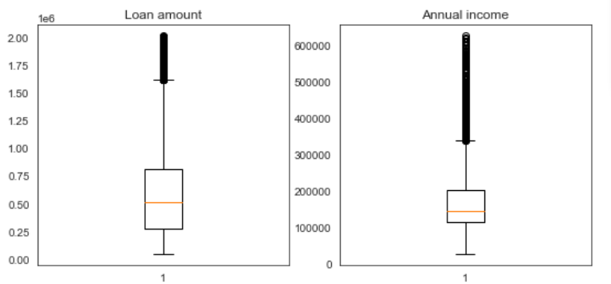
The boxplot for AMT_CREDIT & AMT_INCOME_TOTAL after removing the Outliers is as follows.

Slide 7
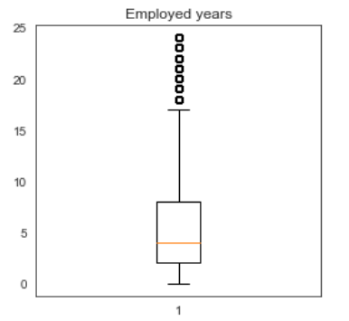
EMPLOYED_YEARS: Max value is 1000 which is very high value and working years can not be a 1000 year, so we will remove the outliers. The following is the boxplot after removing outliers.

Slide 8
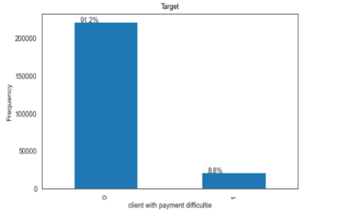
Data Imbalance
We check for data imbalance for the target variable i.e. client with payment difficulties. Following is the bar graph for the same.
It is clearly visible from the graph that the target variable is imbalanced, over 8.8% client with payment difficulties out of 100%.
Therefore we divide the application DataFrame into 2 & do further analysis.

Slide 9
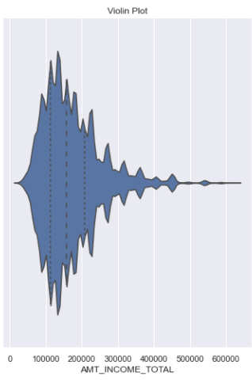
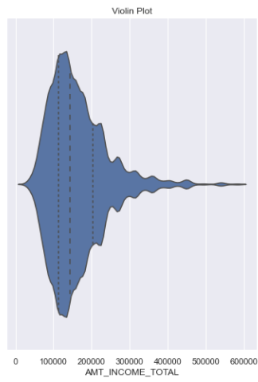
Univariate & Bivariate Analysis
From the violin plot we can infer that both non-defaulters (Target-0) & defaulters (Target-1) come in the same income bracket.

Slide 10
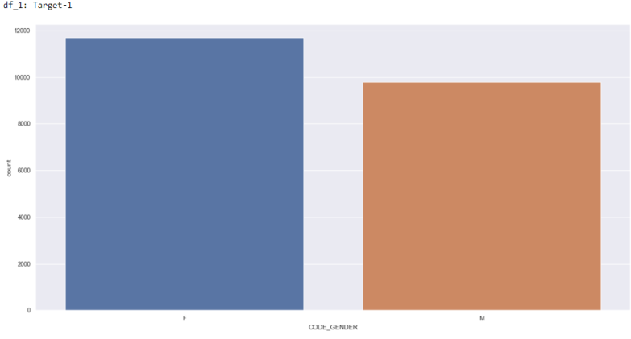
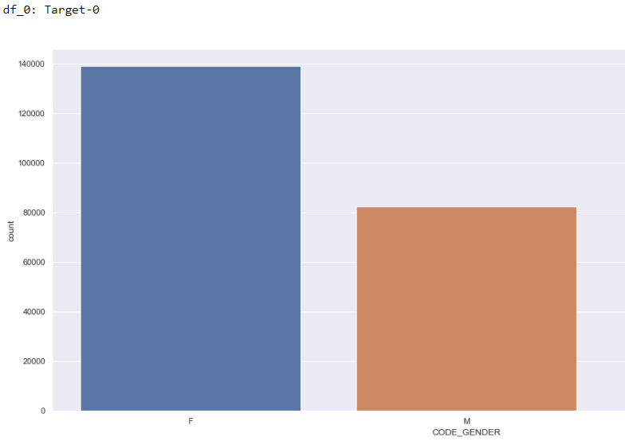
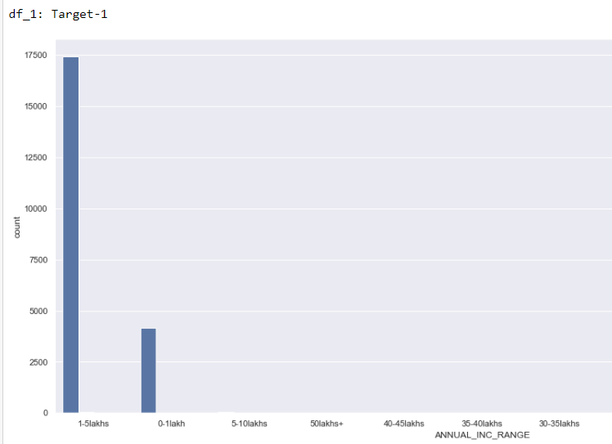

The gender ratio (Female: Male) for the non defaulters (Target-0) vs defaulters (Target-1) is 7:4 & 6:5 respectively.
Bivariate analysis to 'Family Size' and 'ANNUAL_INC_RANGE‘. In Target-1, most of the client are belong to small family, with an annual income between 0-5 lakh who are facing payment difficulties.

Slide 11
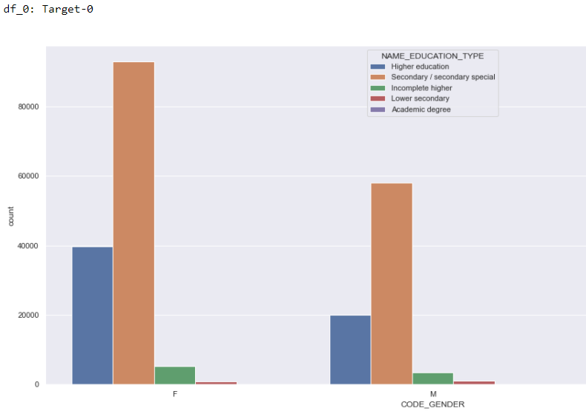
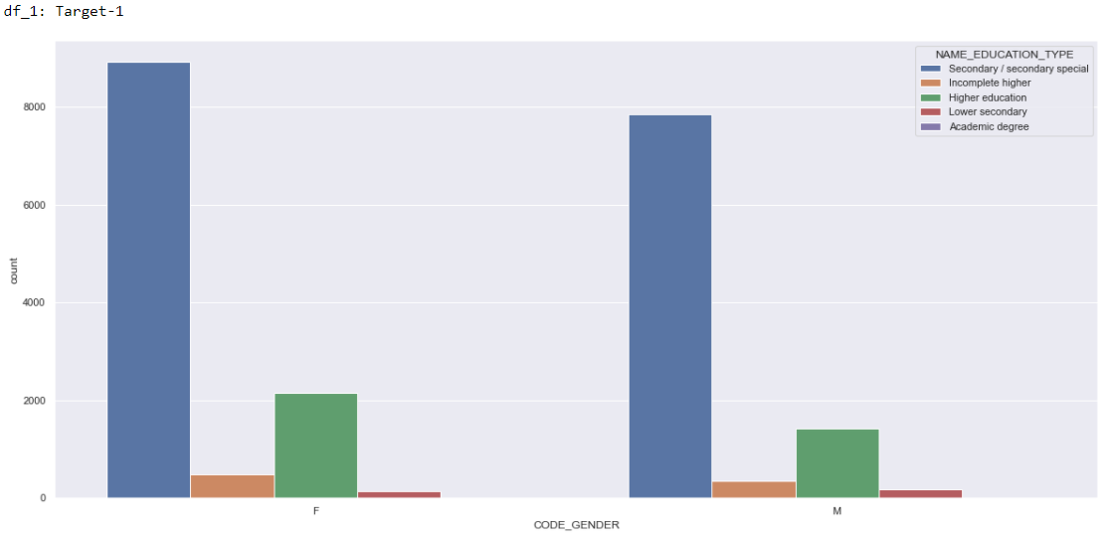
Non defaulters(Target-0) and defaulters(Target-1), female and male frequency of secondary education is high but for defaulters higher education is low this can be one of the reason to find a loan payment difficulties.

Slide 12
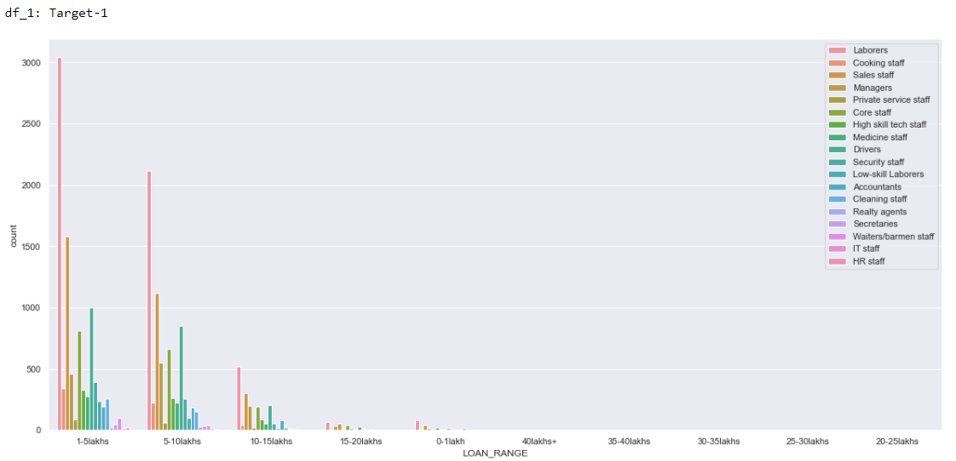
Performing bivariate analysis on 'LOAN_RANGE' and 'OCCUPATION_TYPE‘. In Target-1 Most of the client are from Medical staff, low skilled laborers, Drivers, and Security staff professional background who faces a payment difficulties.

Slide 13
Univariate & Bivariate Analysis ( previous application )
Same processes of data cleaning, manipulation, data type casting and value modification is done on this data as was done on the applications data.
Dividing the application dataset into two dataframe df_Approved and df_Not_Approved.
In case of Approved loan the interest rate is higher side in the category of less then 1 lakh loan when compared to not approved loan.
But in case of not approved loan the interest rate is mixture of higher and middle side in less then 1 lakh and 1-5 lakhs category. This means that some loans have been canceled due to high interest rate. As shown in the following graphs.

Slide 14
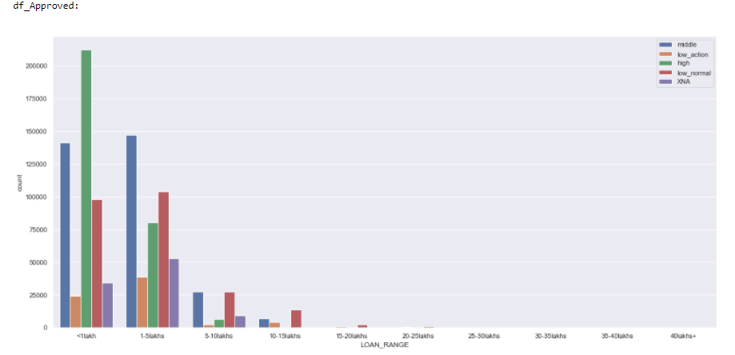
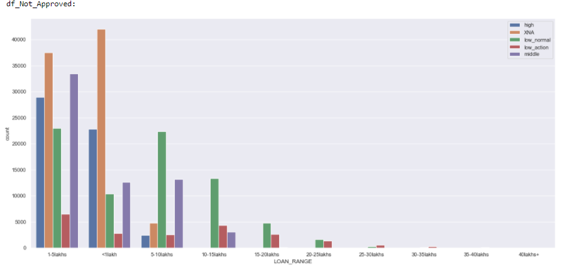

Slide 15
Recommendation's
After thorough Exploratory Data Analysis of applications and previous_applications dataset, crucial variables to consider before loan application approval are:
NAME_EDUCATION_TYPE
AMT_INCOME_TOTAL
OCCUPATION_TYPE
AMT_CREDIT
NAME_FAMILY_STATUS

